Slide 1
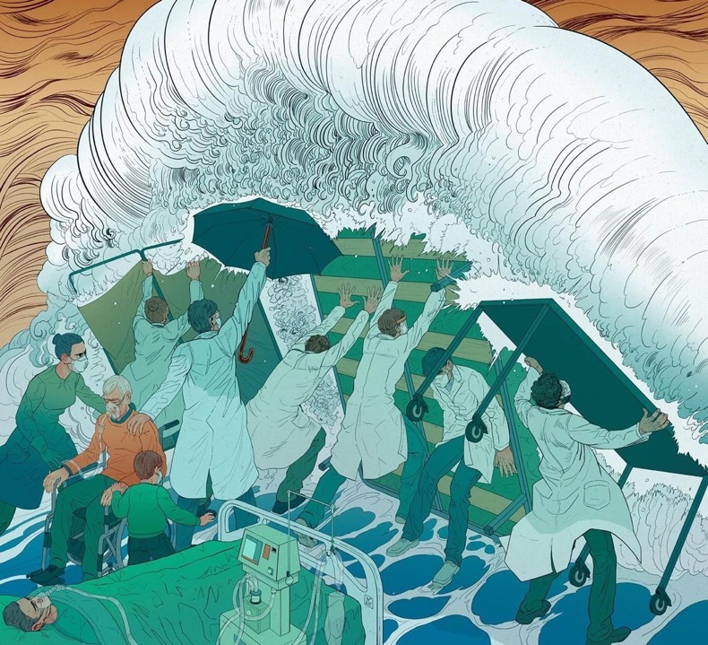
Stress First Aid
Mary Beth Prieur, PhD
Associate Professor
UNC School of Medicine
Departments of Psychiatry & Pediatrics
Psychological Services
Nicolas Castell
Notes:
Nicolas Castell is an artist in Spain who drew this picture as “a tribute to the superhuman work” of the global healthcare community. He said that the image came into his head of how we try to fight the wave of COVID-19 with any possible resource that we have at hand.

Slide 2
Slides/images used with permission from Patricia Watson, PhD; National Center for PTSD
Notes:
Developed for Navy/Marine corps for peer support; then in fire & EMS Depts for self-care
Normally 1-3 day training

Slide 3
Schwartz center webinar(s)
https://www.theschwartzcenter.org/webinar/caring-for-yourself-others-during-the-covid-19-pandemic-managing-healthcare-workers-stress

Slide 4
Double edged sword values & ideals
Slides/images used with permission from Patricia Watson, PhD; National Center for PTSD
Notes:
ACT, DBT – live in line with values
Easier to focus on taking care of others than self? Rely on others to take care of us? Needed b/c those injured don’t always seek support; stigma
Demands impact ability? Moral distress/dilemmas – triage resources, survive when others die, work duties affect family, etc.
”selfish to take a break; others okay (could be worse)”

Slide 5
four Causes of stress injury
Slides/images used with permission from Patricia Watson, PhD; National Center for PTSD
Notes:
Traumatic stress: life threat but lots of others
ED: we’re being injured every day; many of you as well
Stress injuries are sometimes called invisible injuries. Stress injuries are not invisible. Behavior and words are how we see stress injuries.

Slide 6
Stress continuum model
Slides/images used with permission from Patricia Watson, PhD; National Center for PTSD
Notes:
Developed by military
Nash, W. P. (2011). US Marine Corps and Navy combat and operational stress continuum 8 model: A tool for leaders. Combat and operational behavioral health, 107-119.
Cycle in/out zone; can change over time; related to work and home
Less control over reactions; more intense/stronger; injuries can last for a long time – keep from red zone
For many years, the ethos in first responder / healthcare culture has been that after a difficult event, one should be able to tough it out. This is still the case in many departments, where the stigma associated with reacting to stress or stress injury behaviors is still very real and people will try to conceal stress reactions from supervisors to avoid medical or psychological intervention.
However, it is usually not possible to keep these behaviors hidden for long from family members, colleagues and friends. When a co-worker recognizes that someone is in trouble, it is important to break the code of silence. Getting this individual connected with the next level of help as soon as possible may help prevent his or her reaction from progressing into the Red Zone. And once an individual has moved into the red zone, the goal is to help get them into treatment as soon as possible.

Slide 7
Slides/images used with permission from Patricia Watson, PhD; National Center for PTSD
Notes:
7C’s (nautical reference)
Assess in self and others; after any stress, early, ongoing
3-7 necessary in ongoing sense of threat (5); don’t have to have all – different needs individually and as a group throughout; pick what think most helpful – also why important that staff/units who know their people to decide fit/what most helpful; don’t have data to say what’s most important
Providers feel validated in what already doing; “first aid” – not expert mental health

Slide 8
check
Slides/images used with permission from Patricia Watson, PhD; National Center for PTSD
Notes:
What checking for: Guilt (not doing enough, numb, more worried about own family, not coping as well as want/should), anxiety, grief/depression (death, time, income, beliefs, attitudes, moral distress, connection)
Feelings about feelings/gang of feelings

Slide 9
CHECK
Observing: looking for changes in behavior/mood, listening to reports from others, asking questions. Is ongoing and can be done in small ways.
State what you’ve observed (“I noticed you haven’t been eating lunch … you’ve seemed upset/quieter … do you agree?”).
State why you’re concerned (“I care about you … you’re an important part of our team”).
Examples from UNC trainings

Slide 10
coordinate
Slides/images used with permission from Patricia Watson, PhD; National Center for PTSD

Slide 11
coordinate
Ask if they’d like help finding additional resources (others found helpful, try, “interview” MH provider).
You could also offer to help HCP call and get an appointment.
List of Resources: locally, within UNC and nationally
Specifics at UNC
Notes:
; frontline providers often need the extra push

Slide 12
cover
Slides/images used with permission from Patricia Watson, PhD; National Center for PTSD

Slide 13
cover
HCPs may be worried about their own and their families’ safety.
Maximizing safety in the workplace and at home, including physical acts (e.g., washing hands, physical distancing) and psychological reminders (e.g., only so much is in their control, doing everything they can).
It can be helpful to focus on the present rather than what might come.
Think of how you as a leader/supervisor can help instill a sense of safety (take to admin, new policies).
**Be sure to listen for statements about personal safety and immediately seek emergency services if needed.
Examples from UNC trainings
Notes:
Let your team know they can bring concerns to you, and that you could relay these concerns back to administration. Also try to keep your HCPs aware of new policies.

Slide 14
calm
Slides/images used with permission from Patricia Watson, PhD; National Center for PTSD
Notes:
At work and at home
Physical presence and self-care activities
Calm’s goal is to reduce the intensity of physiological, emotional and behavioral activation.

Slide 15
calm
Focused on the mind-body connection; intense stress often leads to feeling hypervigilant, out of control, angry, depressed, anxious, etc.
Emoting calm yourself is important.
“How are you (could you) relaxing/quieting your body at work and at home?”
“What do you find soothing during this time?”
“How are you distracting yourself when needed?”
Are you getting enough rest?” (sleep, etc.)
“Have you noticed a connection between your mental healthy and body symptoms?” (e.g., increase in heart rate, feeling shaky)
“Would you like any more resources to help with relaxation?”
Specifics at UNC
Notes:
Ensure that you spend time daily in a sensory free or completely safe place.

Slide 16
connect
Slides/images used with permission from Patricia Watson, PhD; National Center for PTSD

Slide 17
connect
Covers 3 types of social support.
Everyone is experiencing COVID together but may not be reacting/feeling the same way. Coping isn’t a competition.
Brainstorm ways to help remove barriers to staff receiving the support they need/want.
Instrumental support (e.g., daily tasks): “What tasks can I or others help with at work?” “Would it be helpful if …?” vs. “I would like to do xyz for you today.”
Informational support: “Would it be helpful to read more(or less) about COVID, etc?”
Emotional support: “Who are you able to share your emotions/vent with about your stress?” “Do you feel a sense of community or isolation at home/work?” “How are you staying connected with family/friends?” “Who is supporting/encouraging you through this?”
Examples from UNC trainings
Notes:
Instrumental: Note, this is often well received.
Info: Also advice
(e.g., CDC) “Or, do you think it’d be helpful to reduce amount you read/watch?”
(offer as well)

Slide 18
competence
Slides/images used with permission from Patricia Watson, PhD; National Center for PTSD
Notes:
Self-efficacy
“help restore previous capabilities” or “cultivate personal competence.”

Slide 19
competence
Staff with less experience, feeling intense stress, or who are asked to perform new skills may feel a decrease in competence.
This may be felt not only in work duties, but in parenting, socializing, self-care, etc. Ask about competence in all/some of these domains. Focus on small tasks to build.
“How are you managing all of your roles?” “What area is most stressful for you currently?”
“I feel really proud of your (my) work/so grateful for all you do; do you feel this way?”
“I think you (I) bring xyz/unique skills to the team; what do you think?” (e.g., kindness, technical skills, teamwork - specific)
Examples from UNC trainings
Notes:
Compliment Yourself. How? Be specific: “Because I value being kind I remembered to ask how (coworker) felt about yesterday.”
Feed Self Efficacy. How? Focus on problem you were able to solve especially creatively; reminding self of efficacious nature of your days

Slide 20
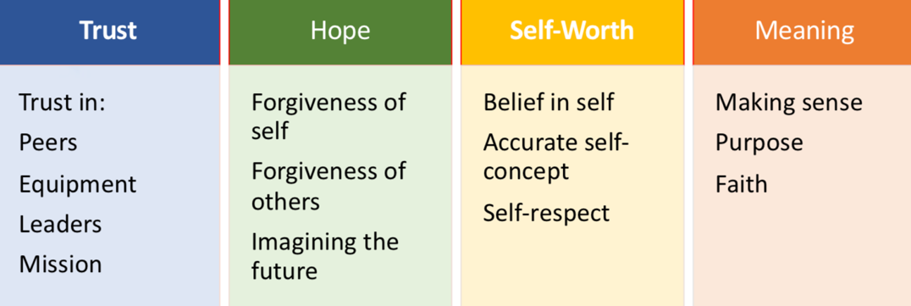
confidence
Slides/images used with permission from Patricia Watson, PhD; National Center for PTSD

Slide 21
CONFIDENCE
Here you are focusing on building self-esteem and hope. You’re also encouraging forgiveness of self (e.g., guilt, blame re: own worries or actions) and others.
“What are you hoping for yourself, family, patients, world?”
“Do you believe in yourself to make it through this trauma/have concerns about handling?” Focus on moments.
“What brings meaning to you during these difficult times?” (e.g., faith, hope, family time, being in nature, finding purpose in your job).
Examples from UNC trainings
Notes:
, “Do you have any concerns about being able to handle what’s going on? What are some things that you have done to cope that have been helpful? How can I/we help you feel like you can get through this?”

Slide 22
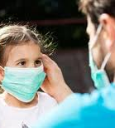
YOUR STRESS IMPACT
SFA SUGGESTS THIS is THE OUTCOME OF A COMBINATION:
- How often you or your colleague experience the expected 4 STRESS INJURIES
- You or your co workers’ unique commitment to the GUIDING IDEALS
- Areas of need for attention within the 5 essential HUMAN NEEDS

Slide 23
Groups/“debriefings”
Possible questions
  What are greatest challenges/rewards?
  What does it mean to be in this unit/on this team?
Slides/images used with permission from Patricia Watson, PhD; National Center for PTSD
Notes:
Focus on present; right now – not processing past experiences

Slide 24
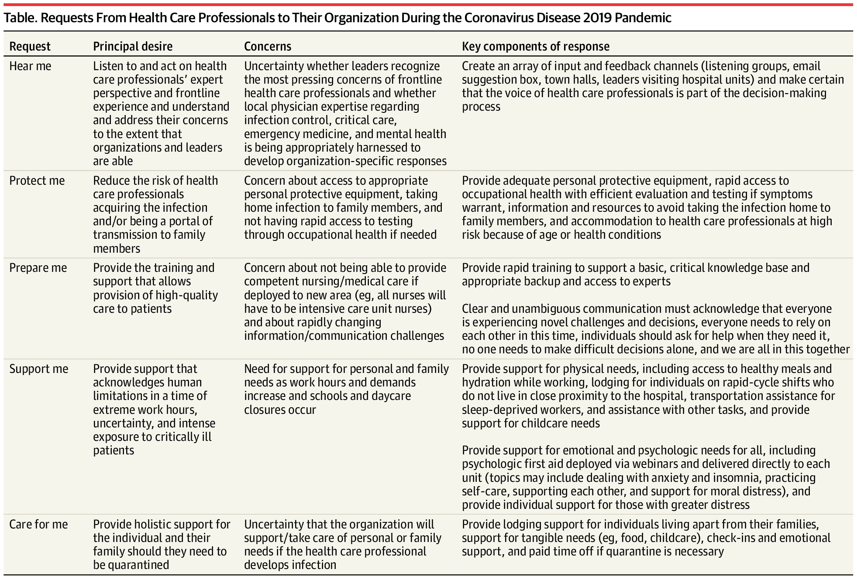
NEJM STUDY

Slide 25
“difficult” situations
You offer to help a co-worker but they keep refusing. What do you do?
You're worried about a difficult week/month. Can you think of any of the C’s that may help you prepare for this?
What are some ways you could increase your and others’ sense of competence?
Can you think of someone whose confidence you admire?
Is there something you can do every day that you will take away from this training?

Slide 26
Ex’s: How integrate
Simply asking questions (more than "how are you?")
Setting a goal question for the week/shift
Encouraging others (e.g., providing more specific praise during/after working together)
Setting a goal number of people to check-in with who are either at work or not during your shift
Having "groups" (cohorts/teams/mentors) or buddy systems that check-in with each other; could be assigned or based on something
Sending a wellness email
Posting info about the Stress Continuum
Offering more training for staff; role-playing in small groups
Encouraging more to watch Schwartz rounds
Having a "family activity" of the week
Having a weekly zoom with a theme (not a formal therapy session but something like "introduce your pet or show us how to make your favorite cocktail"

Slide 27
Resource Review
Within your organization/community?
At UNC
Healing Heroes Helpline
Outpatient Psychiatry
Wellness Webinars
Support Groups
Outside UNC
Headspace
FACE COVID (guide and Youtube video)
SAMHSA Hotline
National Suicide Lifeline

Slide 28
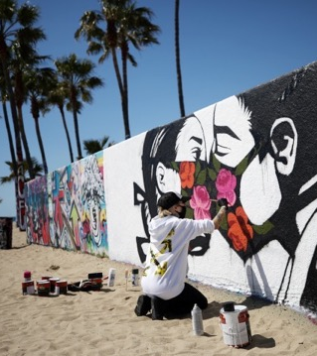
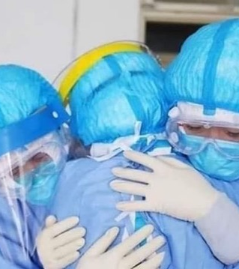
Thank You!
Questions?

