Slide 1
Image courtesy of Anja Wulf (CDC)
DNA-based population screening for precision public health
Laura V. Milko, PhD
Department of Genetics
UNC Chapel Hill

Slide 2
Topics for Today:
DNA-based screening: opportunities and challenges
Relevant topics from the Frontiers special issue* and author perspectives
Utilizing implementation science frameworks
Maximizing clinical utility
Understanding public perceptions and values
Prioritizing health equity in population screening
Expanding genomic screening throughout the lifespan
Addressing informed consent, education, and ELSI for genomic screening
Building effective governance and infrastructure
Conclusions
*https://www.frontiersin.org/research-topics/23213/dna-based-population-screening-for-precision-public-health#articles

Slide 3
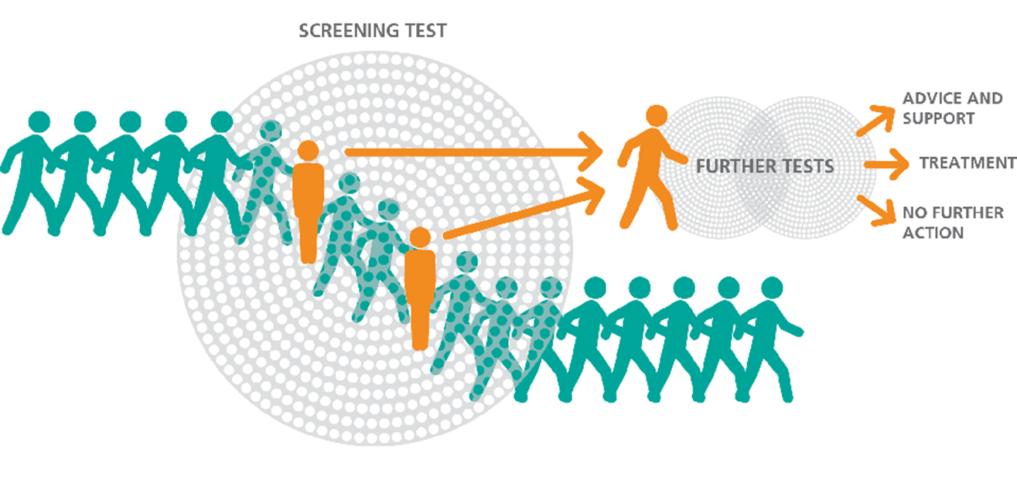
Opportunities
Proactively manage healthcare before symptoms of disease manifest
Identify 1–2% of the adult population with an underlying genetic risk for serious, common diseases such as cancer and heart disease
Detect infants and children with rare monogenic diseases
https://www.gov.uk/guidance/nhs-population-screening-explained
Equalize public health access to precision healthcare
Prepare health care systems for new gene and cell therapies

Slide 4
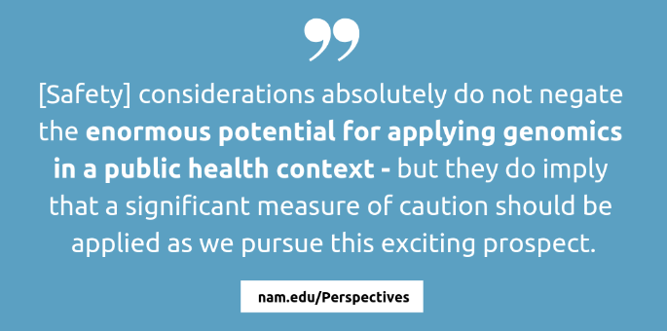
Challenges
Accurate genotype-based ‘diagnosis’ of rare diseases and prediction of poor health outcomes in unselected populations
Overcoming barriers to implementation and equity in primary care and community health settings
Data governance and stewardship that addresses issues of privacy and discrimination
Engagement and education about genomic screening for providers and the public

Slide 5
Utilizing implementation science frameworks
DNA-based screening is increasingly viewed through the lens of implementation science (IS)
IS methods and frameworks facilitate developing and translating effective DNA-based screening practices into routine clinical care:
Understanding community barriers to equitable uptake
Assessing impact on providers and health systems
Evaluating implementation and patient outcomes in primary care and community health settings
Wildin et al. used the Consolidated Framework for Implementation Research (CFIR) to explore barriers and facilitators in a feasibility pilot
Wildin RS, Giummo CA, Reiter AW, Peterson TC, Leonard DGB. Primary Care Implementation of Genomic Population Health Screening Using a Large Gene Sequencing Panel. Front Genet. 2022 Apr 25;13:867334. PMC9081681.

Slide 6
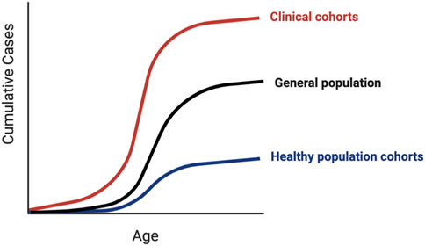
Maximizing clinical utility
Currently available evidence does not provide support for the widespread use of predictive genomic screening in healthy populations.
Ascertainment bias raises valid concerns about overdiagnosis and overtreatment in unselected populations.
Kingdom and Wright urge improving our knowledge base with:
increasing size and diversity of population cohorts
functional studies of individual patients with specific clinical phenotypes.
Kingdom R, Wright CF. Incomplete Penetrance and Variable Expressivity: From Clinical Studies to Population Cohorts. Front Genet. 2022 Jul 25;13:920390. PMC9380816.

Slide 7
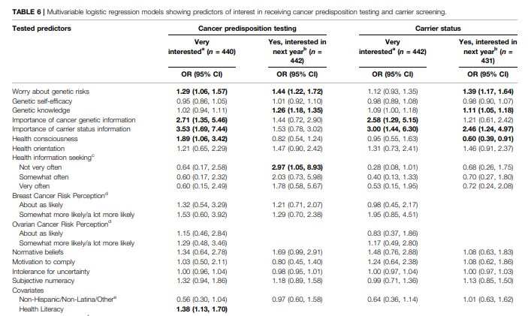
Understanding public perspectives and values
Understanding public values around genomic research will aid in informed decision-making and minimize enrollment barriers.
Kaphingst et al found no difference in Latina and non-Latina women's interest in receiving genetic testing
worry about genetic risks and higher genetic knowledge predicted interest
support for testing as part of routine healthcare
Kaphingst KA, Bather JR, Daly BM, Chavez-Yenter D, Vega A, Kohlmann WK. Interest in Cancer Predisposition Testing and Carrier Screening Offered as Part of Routine Healthcare Among an Ethnically Diverse Sample of Young Women. Front Genet. 2022 Apr 14;13:866062. PMC9047995.

Slide 8
Prioritizing health equity in population screening
New health care innovations can widen existing disparities.
If population genomic screening implementation centers health equity and justice, disparities in access to genetic services could disappear
Involving communities that have been historically marginalized in biomedical research across the design, development, and delivery continuum as Lewis et al. describe, can foster trust-based relationships
Lewis MA, Uhrig JD, Adams ET, Brown JA, Sanders A; RTI International All of Us Innovator Team. Engagement marketing for social good: Application to the All of Us Research Program. Front Genet. 2022 Aug 8;13:889195. PMC10041337.

Slide 9
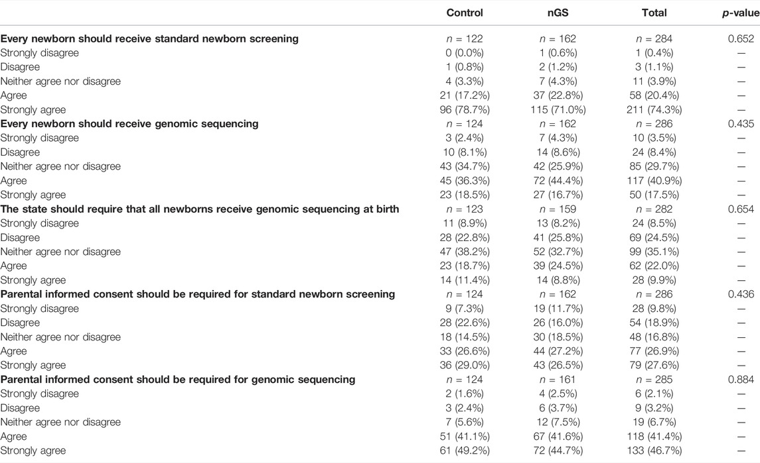
Expanding genomic screening throughout the lifespan
Newborn screening (NBS) epitomizes a highly successful PH screening program
DNA-based screening could significantly increase the no. of screened conditions and access to available, effective treatments
Armstrong et al. caution that expanding NBS without parental buy-in could imperil its continued success
Armstrong B et al. Parental Attitudes Toward Standard Newborn Screening and Newborn Genomic Sequencing: Findings From the BabySeq Study. Front Genet. 2022 Apr 27;13:867371. PMC9091188.

Slide 10
Addressing informed consent, education, and ELSI for genomic screening
Despite the potential for health benefits from emerging new therapies, ELSI and logistical challenges have stalled expanded genomic NBS
Shifting from opt-out to opt-in consent will require innovative education and guidance for practitioners and parents
Rahimzideh et al. argue that rigorous evidence to support supplementing NBS with exome or genome sequencing is still insufficient
Rahimzadeh V, Friedman JM, de Wert G, Knoppers BM. Exome/Genome-Wide Testing in Newborn Screening: A Proportionate Path Forward. Front Genet. 2022 Jul 4;13:865400. PMC9289115.

Slide 11
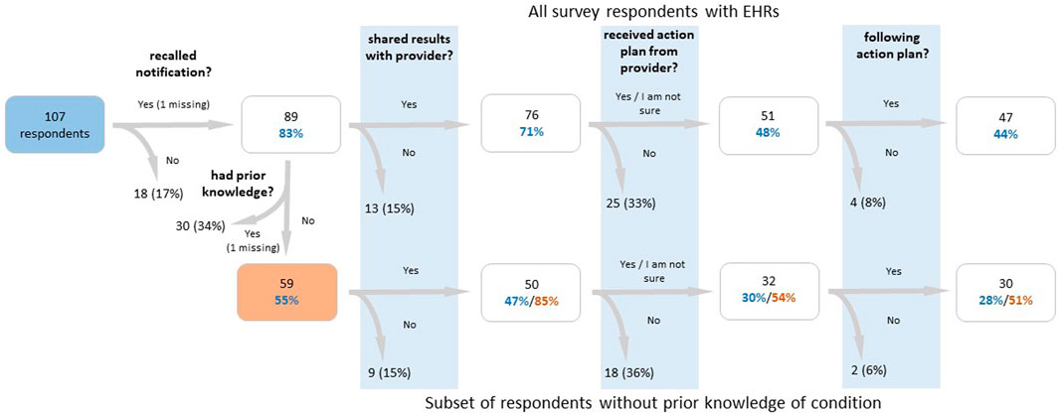
Building effective governance and infrastructure
Effective infrastructure is essential to realizing improvements in public health
The Electronic Health Record (EHR) is a key component for providers and patients
Elhanan et al. propose additional education and support for clinical providers to minimize barriers to clinical action following delivery of genetic findings to patients’ EHR
Elhanan G, Kiser D, Neveux I, Dabe S, Bolze A, Metcalf WJ, Lu JT, Grzymski JJ. Incomplete Penetrance of Population-Based Genetic Screening Results in Electronic Health Record. Front Genet. 2022 Apr 27;13:866169. PMC9091193.

Slide 12
Conclusions
The scientific, ethical and implementation foundation for the widespread use of predictive genomic screening in healthy populations is slowly being built
There is a significant need for research into:
evidence gaps regarding clinical utility and long-term outcomes
barriers to health equity, ethical, legal, and social implications (ELSI)
readiness for implementation in primary care
Implementation outcomes from pilot applications of genetic/genomic public health interventions should be harmonized and shared widely.

