Slide 1
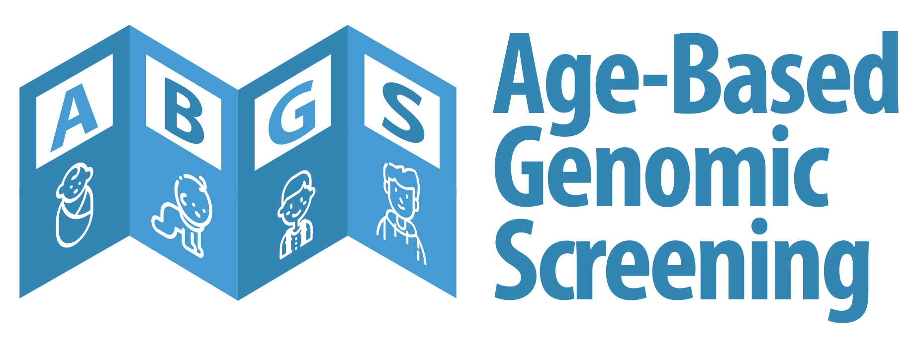
We screen newborns… and there are many opportunities for genomic screening across the lifespan
Jonathan S. Berg, MD/PhD
Department of Genetics
UNC Chapel Hill

Slide 2
“As we learn more about effective interventions for genetic risk factors, and recognize that interventions early in life provide significant advantages, it will become more and more compelling to determine this information at birth.”
— F. S. Collins, The Language of Life: DNA and the Revolution in Personalized Medicine. New York: Harper Perennial (2010)
“The central idea of early disease detection and treatment is essentially simple. However, the path to its successful achievement (on the one hand, bringing to treatment those with previously undetected disease, and, on the other, avoiding harm to those persons not in need of treatment) is far from simple though sometimes it may appear deceptively easy.”
— Wilson JMG, Jungner G. Principles and practice of screening for disease. Geneva: WHO (1968)

Slide 3
Outline
The call for targeted screening in adults, 10 years later
Ongoing challenges to “screening” for monogenic conditions
A new call to consider genomic screening across the lifespan

Slide 4
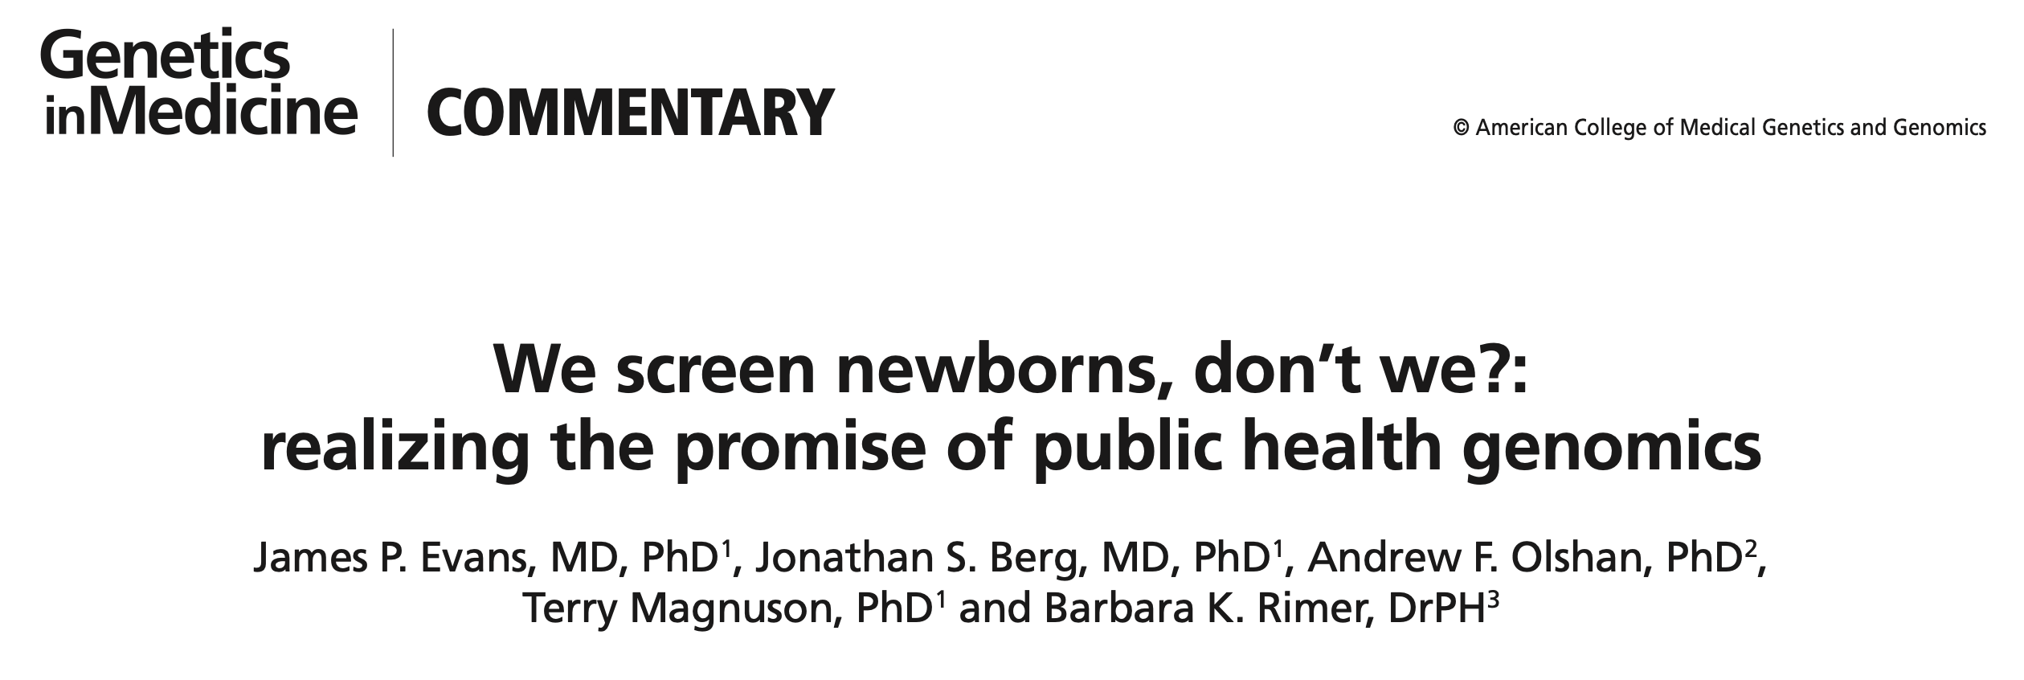
Volume 15 | Number 5 | May 2013 | Genetics in medicine
A proposal for genomic screening in adults
To identify rare individuals who have monogenic conditions that convey a high risk of poor health outcomes that could be preventable with effective interventions
Including considerations about which genes should be screened, thresholds for variant-level results, and the balance against potential negative impacts

Slide 5
NIH-funded research project to sequence 17 genes for 11 medically actionable conditions
Enrolled adults from UNC medicine clinics and Kaiser biobank
Conservative threshold for return of positive findings
Studied patient responses and impact of this form of genomic screening
Gail Henderson, PI
Jim Evans, co-PI

Slide 6
CDC “Tier 1” genes
Various settings for implementation
Informed consent
Engagement strategies
Economic considerations
Cascade testing of at-risk family members
Ethical considerations

Slide 7
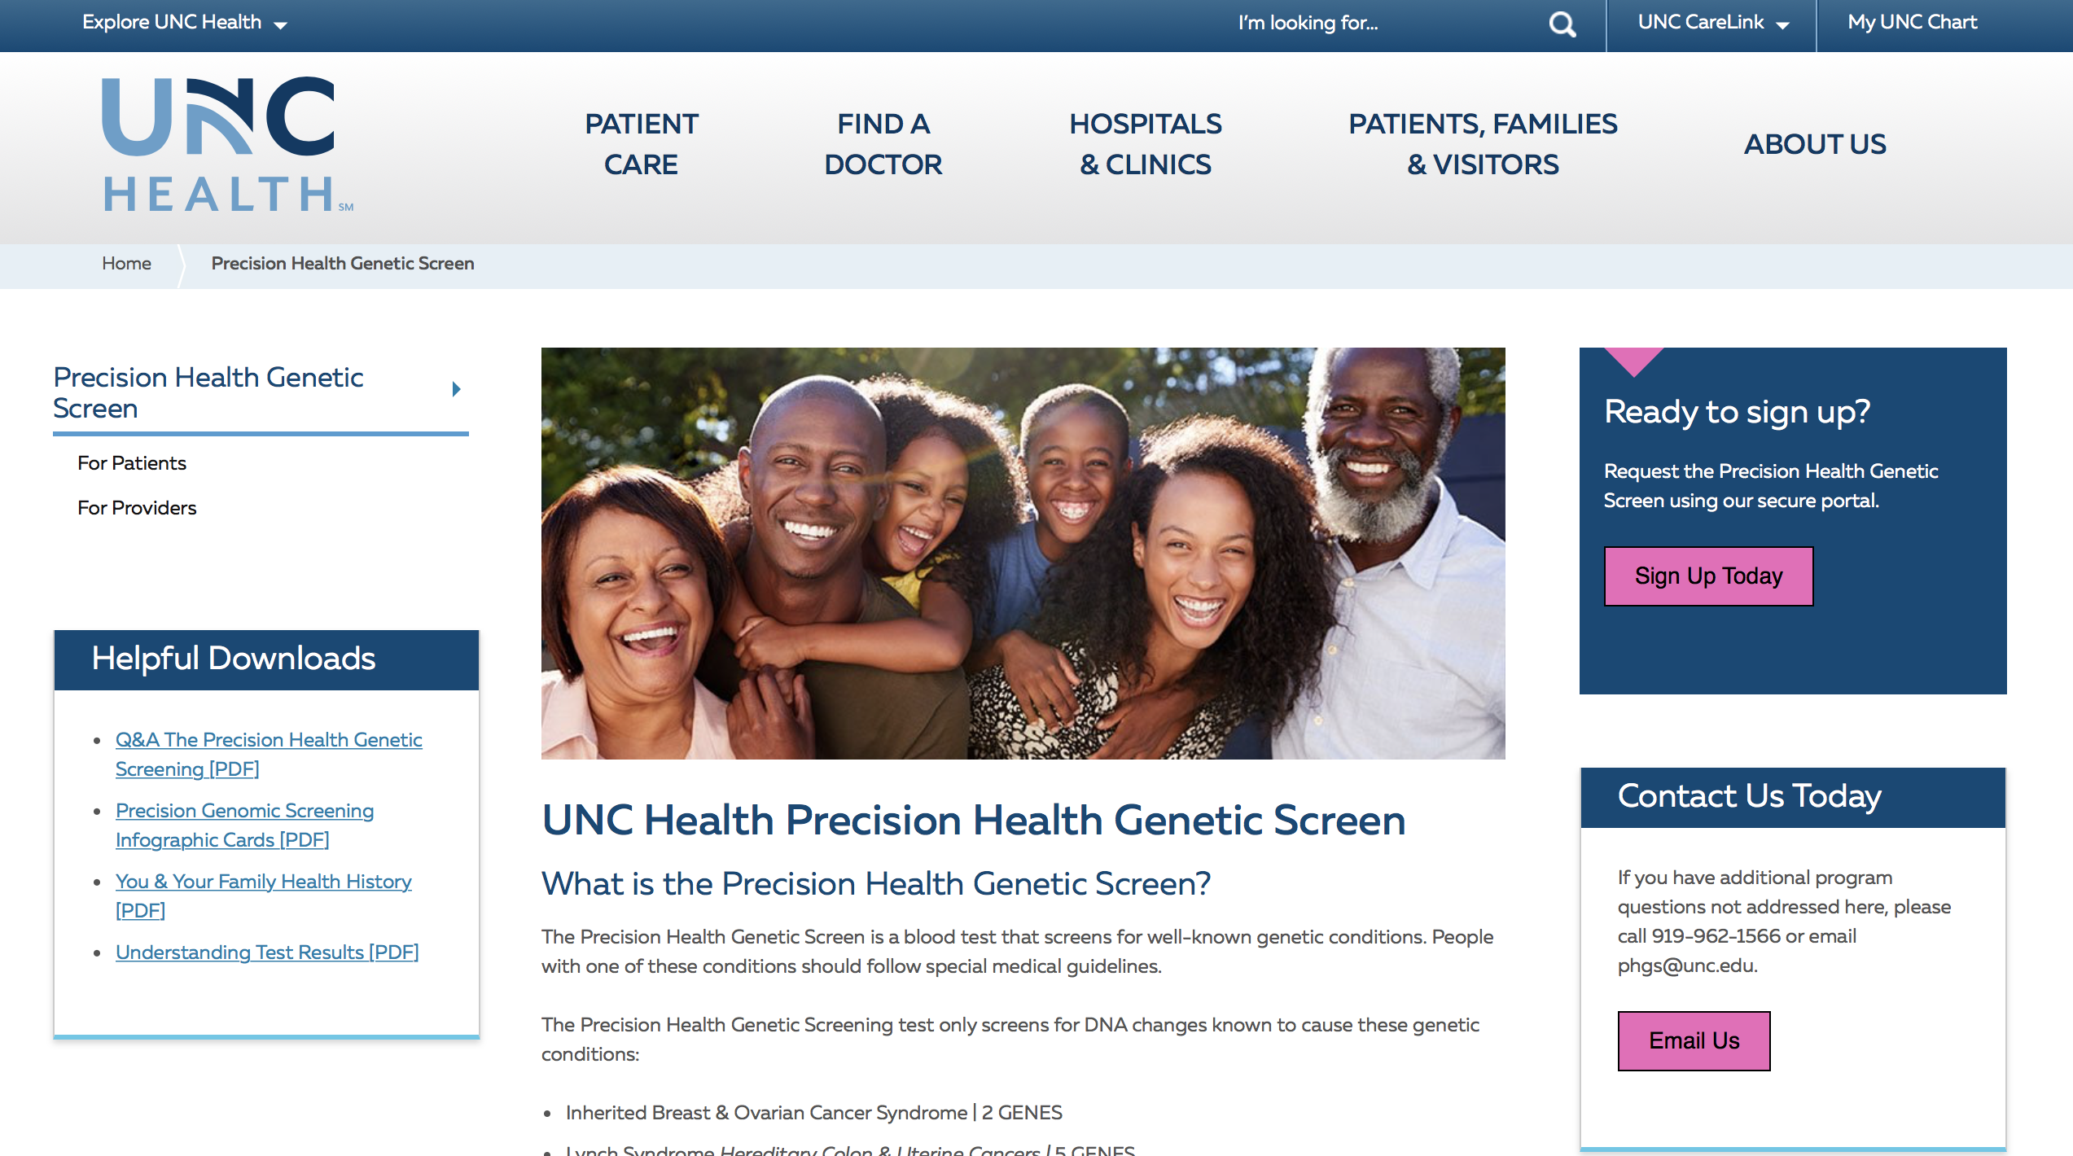
https://youtu.e/Dn7DHdd6jF4

Slide 8
The UNC Health Precision Genomic Screen
Developed as part of the Program for Precision Medicine in Health Care (PPMH)
Free genomic sequencing of 11 medically actionable CDC “tier 1” genes offered to adult patients actively seen in the UNC Health System
The PPMH team will provide end-to-end support
Patient outreach, education materials, promotion
Intake information at time of test order
Electronic results in Epic, results disclosed via genetic counselors
Standard management plans for patients who test positive
Additional recommendations for “high risk” patients who test negative
Our goal: to enable any patient in the UNC Health Care System to have access to genomic screening

Slide 9
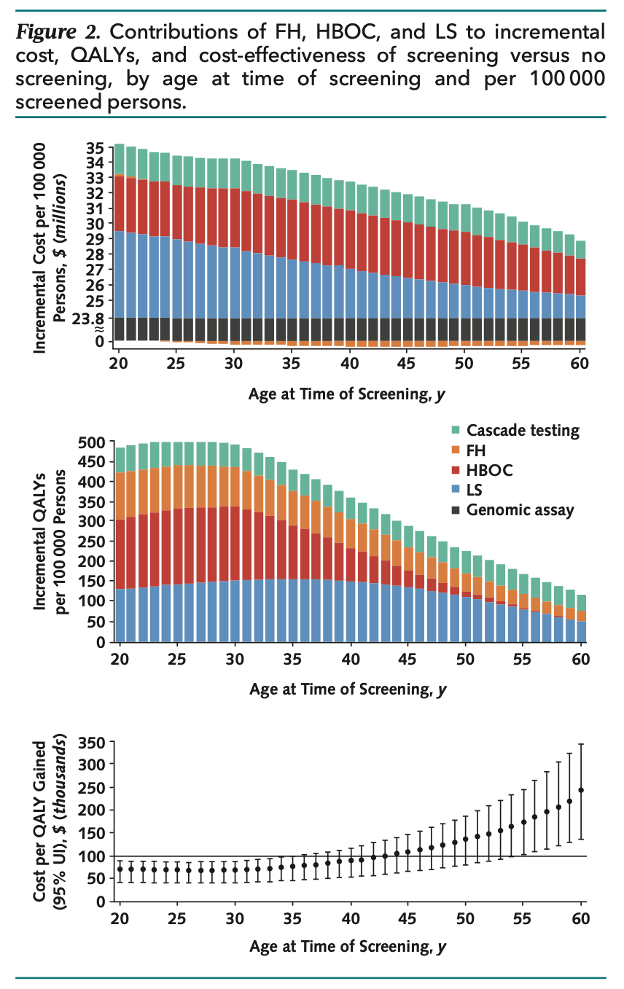
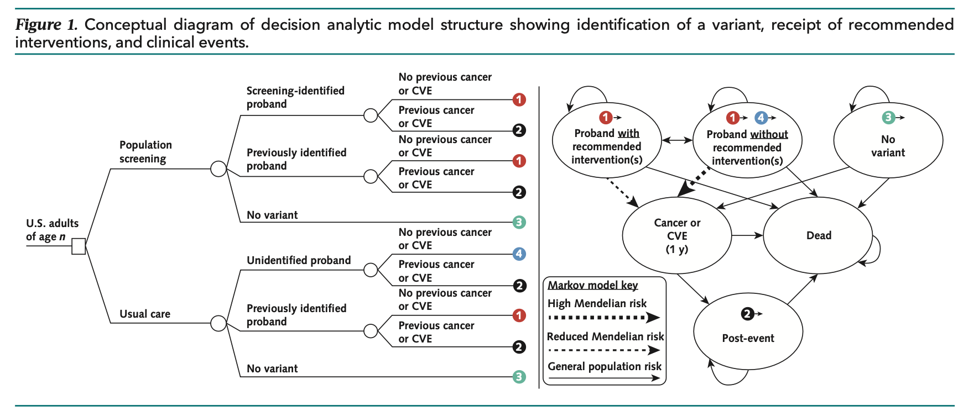

Slide 10
Some early lessons learned
Approximately a decade from idea to implementation
Some patients are interested, but often because of a personal or family history that might be better addressed with clinical testing
Few harms documented, relatively modest benefits
Cost effectiveness analyses support CDC Tier 1 conditions as an initial starting point for genomic screening
What are the ongoing challenges?

Slide 11
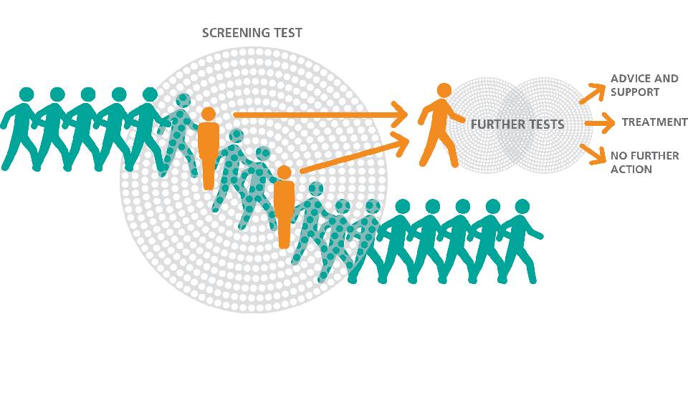
Normal population risk for poor health outcomes
https://www.gov.uk/guidance/nhs-population-screening-explained
Traditional “screening” tests done in public health and medical care are often not thought of as “diagnostic”
Need a secondary test to confirm
E.g. Mammography BIRADS category 5 equates to a 95% likelihood of cancer
A monogenic “disease” is a specific diagnosis that itself does not mean any given manifestation exists or will develop
Monogenic disease
High risk for poor health outcomes

Slide 12
Burden of disease associated SNPs as a predictor
Genome-wide association studies (GWAS) have been used to identify loci (typically single nucleotide polymorphisms) that are statistically enriched in people with a variety of phenotypes (diseases, quantitative traits, etc.)
Genetic risk profiles can be derived from the burden of these risk SNPs
Unaffected
Affected
They just aren’t as predictive as we would like them to be for routine clinical use!
And, there are serious issues with the ability to use these predictors in diverse populations, given that the majority of GWAS to date have been conducted in Europeans (although this is being actively addressed)
Number of people
Genomic risk score

Slide 13
Analyte tests can be calibrated
Unaffected
Affected
Number of people
Minimal false negatives, many false positives
Minimal false positives, many false negatives
Analyte concentration
Is there an equivalent mechanism to define a positive “screen” for variants?

Slide 14
Clinical classification of genetic variants
Interpreted with respect to a specific monogenic condition
Possibly informative,
but also potential false positives
Benign
Pathogenic
Likely (<10%)
Benign
Variant of
Uncertain
Significance
Likely (>90%)
Pathogenic

Slide 15
Genomic sequencing as a “screen”
Every test that is used for binary classification (disease/not disease) has a defined test performance
Receiver Operating Characteristic curve
Relationship between sensitivity and specificity for any given cut-off value
Area under the curve (AUC) gives a measure of test performance
Better tests have higher AUC
0.9
0.7
How can we assess the performance of genomic sequencing as a “screening” test?
0.5
Sensitivity / TPR
1-specificity / FPR

Slide 16
True
negative
https://www.gov.uk/guidance/nhs-population-screening-explained
False
positive
When ascertaining individuals with monogenic disease via screening, we will identify a “molecular diagnosis”
Indicating a probability of having the disease
As well as the probability of poor health outcomes that are associated with the disease
PPV for the monogenic disease will depend on prevalence and the specificity of results
Combined with post-test phenotyping
True
positive
False
negative

Slide 17
Case finding
Relies on high clinical sensitivity (few false negatives)
How much locus heterogeneity exists?
What fraction of disease-causing variants are known versus novel?
Negative predictive value is strongly influenced by prevalence
In rare conditions, NPV is relatively preserved even with decreased sensitivity
How bad would it be to miss a diagnosis?

Slide 18
Limiting false positives
Relies on high technical and clinical specificity
Does the test give you technical artifacts?
Is the variant classification of pathogenicity correct?
Positive predictive value is strongly influenced by prevalence
In rare conditions, PPV is heavily penalized when specificity is <99.9%
How problematic would it be to have a false positive?

Slide 19
Will not develop poor health outcome
https://www.gov.uk/guidance/nhs-population-screening-explained
Assuming that the molecular diagnosis is correct, what can we expect?
The natural history of the disease (age-related penetrance, expressivity) will determine the chance of poor health outcomes among people with the monogenic condition
In some instances, people in the general population can develop the same poor health outcomes (we call these phenocopies)
Will develop poor health outcome

Slide 20
Overdiagnosis
When people are labeled with or treated for a disease that would never cause them harm
Inherent in any screening program
Eg. PSA, mammography, cholesterol, etc.
Anything that increases risk for a poor health outcome but does not directly diagnose or cause the disease in question
Can lead to overuse of further tests and treatments
Some of which may be harmful
Example: identification of a BRCA1 pathogenic variant in a woman with no personal or family history of cancer -- will prophylactic surgery help? Or would she never have developed cancer?
What value does genomic screening add to health care?

Slide 21
Overdiagnosis - Factors specific to genetics
Incomplete penetrance
Current estimates likely flawed due to ascertainment bias
Genetic and non-genetic modifiers
Variable expressivity
Difficult to predict age of onset and severity of symptoms
True phenotypic spectrum not known for many rare conditions
Population screening may require weighing thresholds on a condition-by-condition basis to balance benefits and harms

Slide 22
What are the post-screening groups?
TN (normal risk, normal management)
FN (high risk, normal management)
FP (normal risk, increased management)
TP (high risk, increased management)
https://www.gov.uk/guidance/nhs-population-screening-explained
Those who screen negative can still develop poor health outcomes (e.g. cancer, heart disease)…
Do they understand that they are still at population risk?
Do they understand that the screening test does not “rule out” a monogenic disease and that their personal and family history might indicate the need for further evaluation?
Those who screen positive may never develop poor health outcomes…
Do they understand the probability of an incorrect “molecular diagnosis”?
Do they understand the implications their results have for family members?

Slide 23
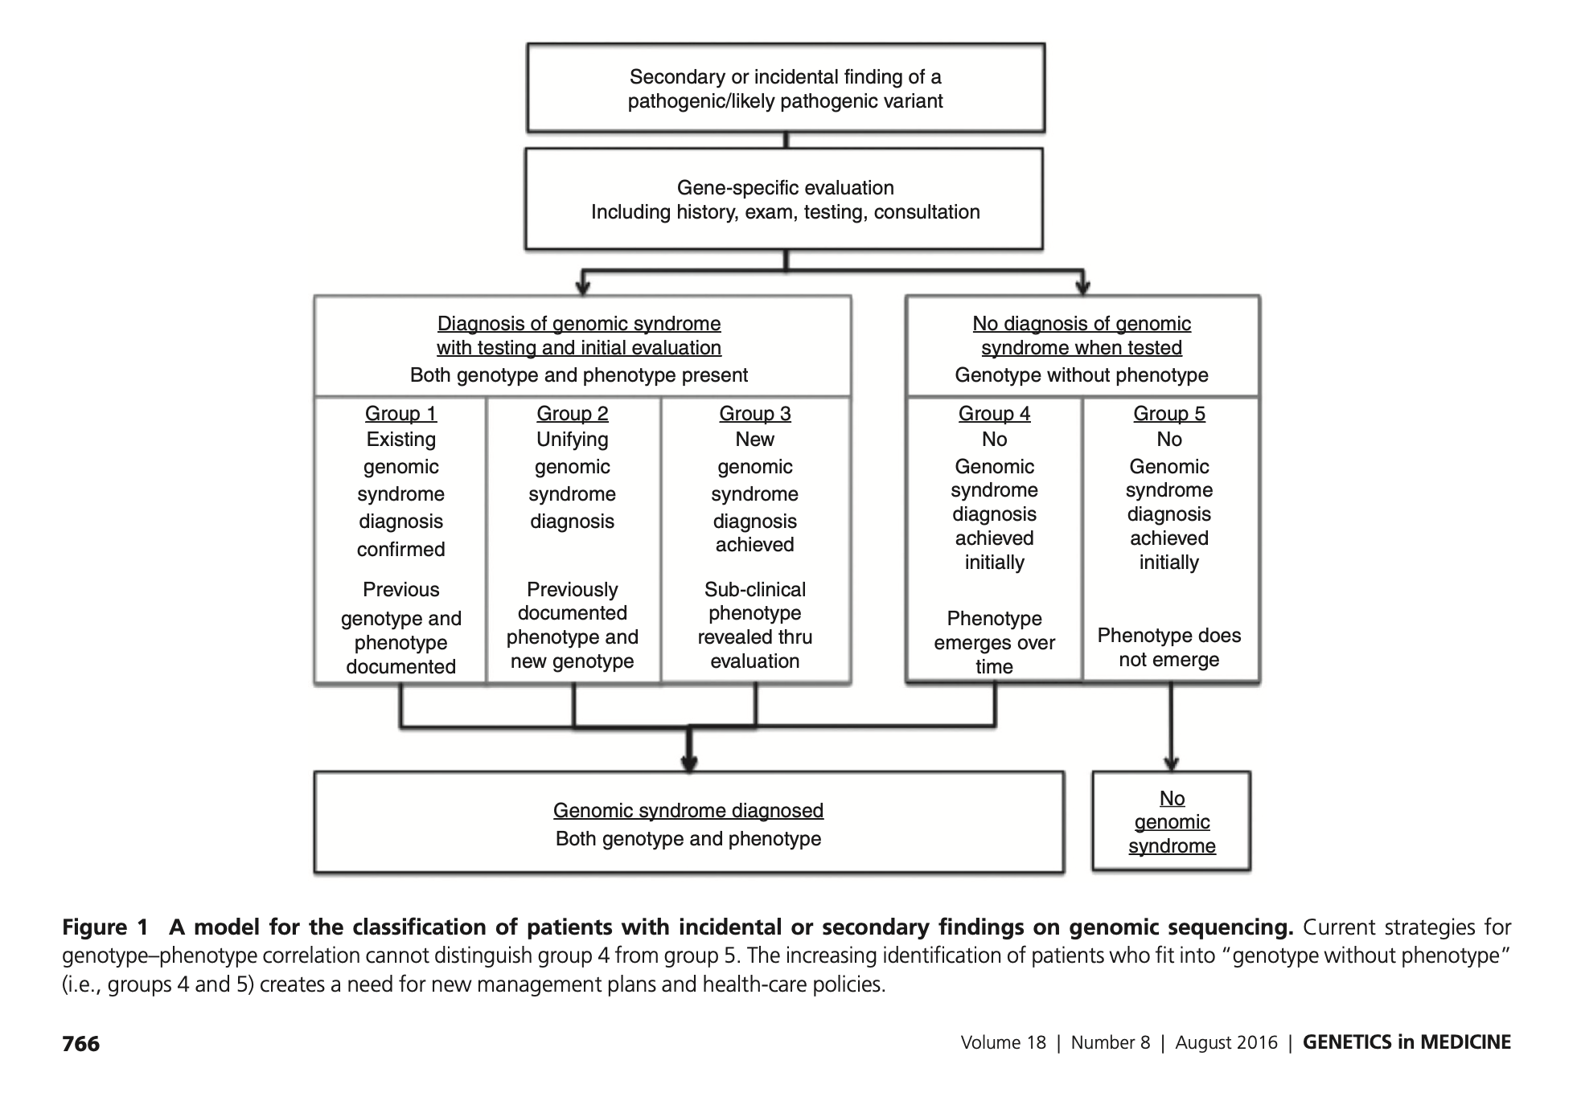
From genomic findings to diagnosis
Mike Murray

Slide 24
Categories of results in PHGS
Negative:
1. Reassuring, concordant with negative personal or family history
Does not exclude possibility of developing sporadic disease
2. Uninformative, discordant with family history
Clinical follow up recommended
Informative diagnosis identified (true negative or false negative)
No informative diagnosis
3. Uninformative, discordant with personal history
Clinical follow up recommended
Informative diagnosis detected (false negative)
No informative diagnosis
Positive:
1. Confirmatory molecular diagnosis concordant with personal history
E.g. meets NCCN guidelines or Dutch criteria, participant would have been recommended to follow up with clinical Genetics if population screening was negative
Already had a clinical or even molecular diagnosis
2. Molecular diagnosis concordant with family history
Explanatory: family member with consistent history has the same molecular diagnosis
Non-explanatory: family member with consistent history does not have molecular diagnosis
3. Molecular diagnosis without known personal or family history
Unexpected “true” population screening positive without suggestive personal or family history
Unclear predictive value for penetrance/expressivity
A person can move from an uninformative to informative state over time

Slide 25
Genomic screening across the life span
We now screen newborns and adults, don’t we?
Early economic analyses point to optimal time points for screening (at least from the perspective of cost-effectiveness)
Should we be thinking about the many different times at which individuals might undergo screening?
And if so, what should be screened for, and when?

Slide 26
Age of onset / intervention
Definitive intervention
(e.g. Surgery)
Rapid application of definitive therapy
(e.g. diet, enzyme therapy)
Definitive intervention
(e.g. ICD placement)
Cumulative onset
(age-based penetrance)
Proximal intervention
(e.g. Surveillance)
Proximal intervention
(e.g. Surveillance)
Age
Age
Age
Optimal timing will be a balancing act
The latency between molecular diagnosis implementation of interventions
The impact of latency on efficacy of the intervention vs. overtreatment
The burden of longstanding follow-up, availability of specialists, and ability of primary care to manage
Notes:
One way to address the question of how to create parameters for age of onset. Here looking at a curve with age and cumulative onset as the axis’. This graph depicts disease course progression of a later onset disease (potentially a hereditary cancer) with peak occurring in latter years. Surveillance would begin around the age of 25 and definitive intervention would occur in here, later on, closer to the peak. Based on this idea/figure/visual, I think next steps would be to look in the literature for surveillance and intervention age ranges to try to determine timepoint between for intervention prior to symptoms.

Slide 27
Age-based genomic screening
Integrate population-level targeted genetic screening for highly actionable, age-relevant conditions, into routine wellness visits for newborns and children
Who / what /when / where / how ?
0 5 10 15 20
Avoids many of the challenging ELSI issues related to sequencing in newborns and children
Gradually introduces genomic screening over time, preparing adolescents to engage in decision-making when they reach adulthood

Slide 28
An ethical framework for genomic screening in children
Beneficence (early detection) versus nonmaleficence (do no harm)
What conditions should be screened for (efficacy, burden of interventions, potential for “overdiagnosis,” implications for families)
What variants should be returned (concern about false positives)
Autonomy
The parents’ duty to act in the best interests of the child (in this case specifically to prevent poor health outcomes in childhood) versus the child’s interest in self-determination and autonomy
The information needed for parental decision-making and consent to “opt in” versus the public health imperative to screen all newborns with an “opt out”
Distributive justice
Making genomic screening as accessible as possible, including considerations of access to specialty care for those who screen positive
Engaging community members in design of the program and outreach to ensure parents are prepared to make decisions

Slide 29
Specific Aims
1. Refine the content and timing of targeted panels based on evidence and expert opinion
2. Assess organizational context, barriers, and facilitators for ABGS implementation in clinics
3. Examine parental and community perceptions and dismantle barriers to participation in ABGS
4. Evaluate the feasibility of ABGS through a pilot study in diverse pediatric clinics in NC
Notes:
INCLUDE SPECIFIC AIMS IN SUBSEQUENT SLIDES?!?

Slide 30
Horowitz CR et al. The Genomic Medicine Integrative Research Framework: A Conceptual Framework for Conducting Genomic Medicine Research. Am J Hum Genet. 2019 Jun PMCID: PMC6556906.

Slide 31
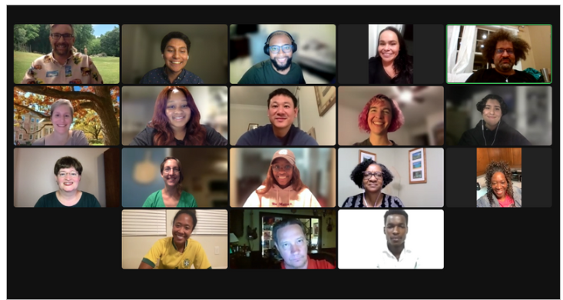
Community Research Board (CRB)
Powell SN, et al. Parental Guidance Suggested: Engaging Parents as Partners in Research Studies of Genomic Screening for a Pediatric Population. Front Genet. 2022 Mar. PMC8990237. –
5 CRB co-authors!

Slide 32
Acknowledgements:
Key investigators
Marcy Boynton
Grace Byfield
Heidi Cope
Neal DeJong
Kate Foreman
Kim Foss
Gail Henderson
Michelle Hernandez
Jessica Hunter
Liz Jalazzo
Julianne O’Daniel
Holly Peay
Bradford Powell
Cindy Powell
Sabrina Powell
Jen Rees
Megan Roberts
Samantha Schilling
Maggie Waltz
Jean Cadigan
Community Research Board
Michael Austin
Ashley Bennetone
Larry Bradon
Erin James-Crook
Marlon Nunez
Andreas Orphanides
Heather Osborne
Thomas Owens
Ken Ray
Carla Robinson
Jon Shaw
Trainees
Jahnelle Jackson
Ella Branch
Project Managers
Stefanija Giric
Langston Harrison
Daniel Torres
R01 HG012271

